Slide 1
FarmaSee
Interação Humano-Computador
Dário Matos (89288)
Pedro Almeida (89205)
Samuel Duarte (89222)

Slide 2
Introduction/Problem
FarmaSee
The world’s current status leads us to develop new ways of doing our day-to-day activities in different ways than we are used to. To do so, most of human interaction must preserve some physical distance. More so, it’s now crucial for healthcare facilities and establishments to be the more effective and efficient possible.

Slide 3
Objectives
FarmaSee
Our main goal is to provide a way for customers to interact with a pharmacy remotely, with no risk of exposure, and still be able to get a variety of products needed. It is also a “smart” way for establishment’s personnel to keep track of the store’s activity.
By doing this, we are hoping we can help the ones in need.

Slide 4
Interview 1
FarmaSee
The first interview starred a concerned female citizen of Matosinhos. Due to the status of the healthcare service, she is afraid that going out to buy medicine will be a risk, and considers that should be done the quickest way possible. In her opinion, it would be extremely beneficial to be able to get to a farmacy and pick up medicine without having to wait in lines, this way saving time and reducing social interaction.

Slide 5
Interview 2
FarmaSee
The second interview starred a middle aged man who suffers regular headaches and therefore is in need of medicines much more than a regular person is. He manifested that a system that would allow him to buy his medication wherever and whenever he needs would be a great improvement to his quality of life. He also sees an opportunity to help the older generation with this system, however admitted it could be difficult to some older people to start using technology and so the system will need to be super easy to learn and use.

Slide 6
Interview 3
FarmaSee
The third interview was with a male living in Viseu. This person has problems dislocating to a pharmacy to buy the pills in his prescription. So to make his day-to-day life easier, he would like a system to be created were he can buy his medicine and get delivery it at his house without leaving the comfort of his home.

Slide 7
Personas
FarmaSee
Madalena Claro
Mother of 2 children, farmaceutical graduated by Universidade da Beira Interior, Madalena owns a pharmacy in a small town on the countryside, where she lives. The 42 year old is willing to invest to improve her establishment’s service, bearing in mind the confinement situation of the country, as she always had a desire to do help the ones in need.

Slide 8

Personas
FarmaSee
José Dias
José is now retired, he lives with his wife in a village near Porto. When he was young he suffered an injury while doing his military service and as a consequence he suffers a chronic pain in his leg. Therefore, José has some trouble driving and his wife does not have a license. José hopes that the emerging technology could help him with is limited movement.

Slide 9
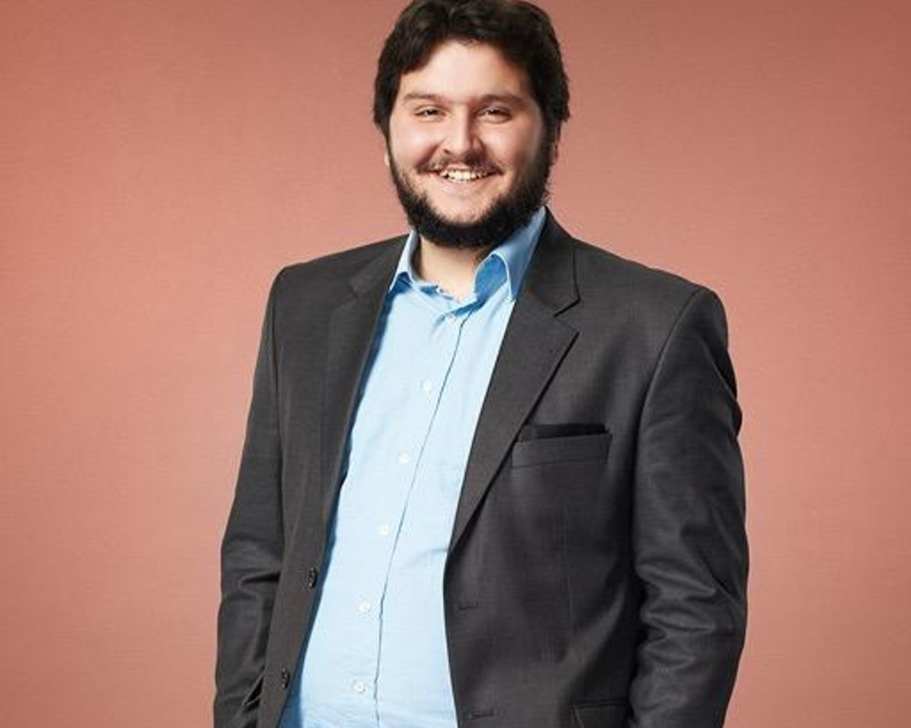
Personas
FarmaSee
Miguel Valongo
Miguel is a 38 year old man who works as deputy mayor of a town on the Portuguese shore. Father of 1 and dedicated husband, every week he buys from the local pharmacy medicine for his wife. Trying to make the most of his already little free time to spend with the family, and due to his varying schedule, Miguel would benefit from being able to virtually purchase medicine, to pick up quickly and when it suits him the most.

Slide 10
Scenarios
FarmaSee
Scenario 1
Goal: Buy medicine
Interaction:
As a disabled person, José Dias wants to be able to buy medicine from home, so that he doesn't have to leave his home due to his physical condition.

Slide 11
Scenarios
FarmaSee
Scenario 2
Goal: Check purchase history
Interação:
As the owner of a pharmacy, Madalena wants to check the purchase history of a client to verify if it’s usual for the customer to buy certain medicine.

Slide 12
Scenarios
FarmaSee
Scenario 3
Goal: Reserve medicine
Interação:
Miguel, who drives by multiple pharmacies on the way home, wants to reserve the medicine so he can pick it up later.

Slide 13
Tasks:
FarmaSee
Buy/Order medicine
Analyse drug record

Slide 14
Task 1: Buy/Order medicine
Login
Select medicine(s)
Upload prescription if required
Choose the pharmacy
Pick between delivery home or pick out at the pharmacy
Payment online or at delivery

Slide 15
Task 1: Buy/Order medicine (HTA)

Slide 16
Buy/Order medicine
Login
Customise Order
Proceed To Payment
Insert Credentials
Choose Medicine
Choose Farmacy
Select Delivery Method
Select Payment Method

Slide 17
Task 2: Analyse drug record
Login as pharmacy owner
Search the client
Analyse the purchase history

Slide 18
Requirements
FarmaSee
Non-functional requirements
Intuitive user interface
Reliable system
Secure data handling
Functional requirements
Each user should only use the app after an authentication on the platform
Regular users and establishment owners should be able to see the list of medicines
Every user should be able to select the pharmacies that own a certain medicine to order from

Slide 19
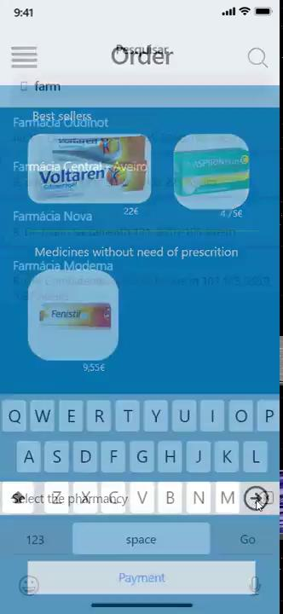
Low Fidelity Prototype
FarmaSee

Slide 20
LFP User Evaluation
FarmaSee
We wanted to evaluate the difficulty of performing the funcionatonal requirements previously defined.
We addressed two scenarios: buying medicine and checking purchase history.
We were able to use every critical task.
Changes made after the LFP User Evaluation:
At the History Page, adding the date of purchase
At the Payment Page, adding buttons to increase and decrease the quantity

Slide 21



LFP User Evaluation
FarmaSee
The Functional Prototype is now displaying the products to buy in lists. It also features a consistent Menu page, a new Profile page, and different pictures of the products.
Beyond that, the navigation is now possible through more intuitive buttons commonly used in other apps in the market and some functionalities were developed to provide a more dynamic experience.

Slide 22
Platform Used for the Functional Prototype
FarmaSee
The programming environment was Visual Studio (Windows machines).
The functional prototype was developed using Windows Presentation Foundation (WPF), and the programming languages used were C# and XAML.
As for the icons, it was used the “MaterialDesignThemes.WPF” gallery.
No specific hardware was used.

Slide 23
User Evaluation of the Functional Prototype
FarmaSee
Five tasks
Task 1 - View/confirm profile data
Task 2 - Insert prescription code and check if the right medicines were selected
Task 3 - Search for a specific drug, select a pharmacie to buy from and advance to the payment page
Task 4 - Select the payment and delivery method
Task 5 - View pending deliveries or pick-ups
Changes made after the usability test
Tooltips
Enter shortcut in SearchBox
Remove DoubleClick when selecting the pharmacy

Slide 24
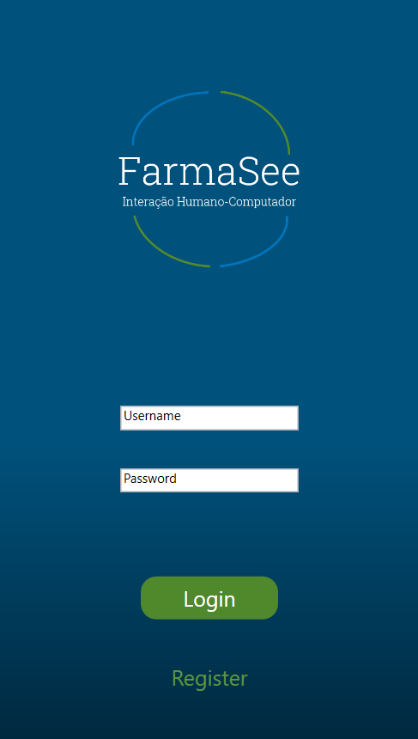
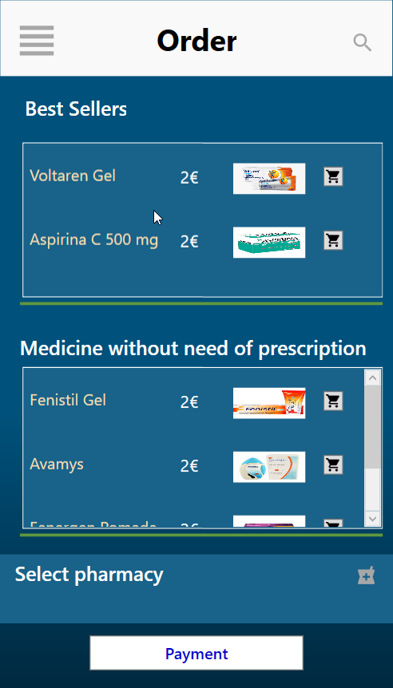
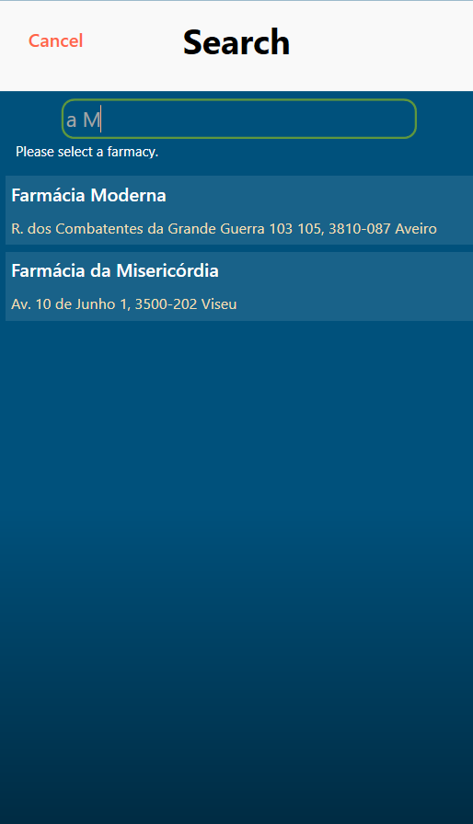
Demo
FarmaSee

Slide 25

Demo
FarmaSee

Slide 26
Future Work
FarmaSee
Connect to a remote database.
Migrate the project to a mobile platform (example: Xamarin)
Establish partnerships with local pharmacies.
Retrieve more feedback from the users to improve the application and maybe implement more functionalities.
Ability to track the order when delivered at home

Slide 27
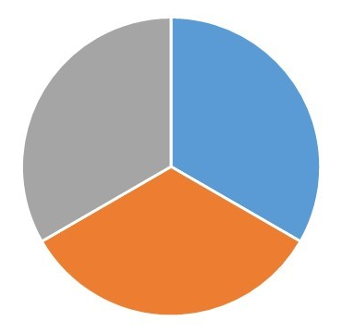
Effort of each group member
FarmaSee
Each member of the group has split his focuses throughout the semester in order to work simultaneously and in equally amount as the others, leading to an equal division of effort (33,3%).
This division proved itself to be the most time efficient, specially due to other projects being developed simultaneously.

Slide 28
Acknowledgments
FarmaSee
The group members have considered this project to be very rewarding, not only in what concerns technologies learned, but also in the process of building intuitive mobile applications through users’ feedback.
We would like to thank the teachers Beatriz Sousa Santos and Pedro Almeida for the continuous support and feedback.

